Slide 1
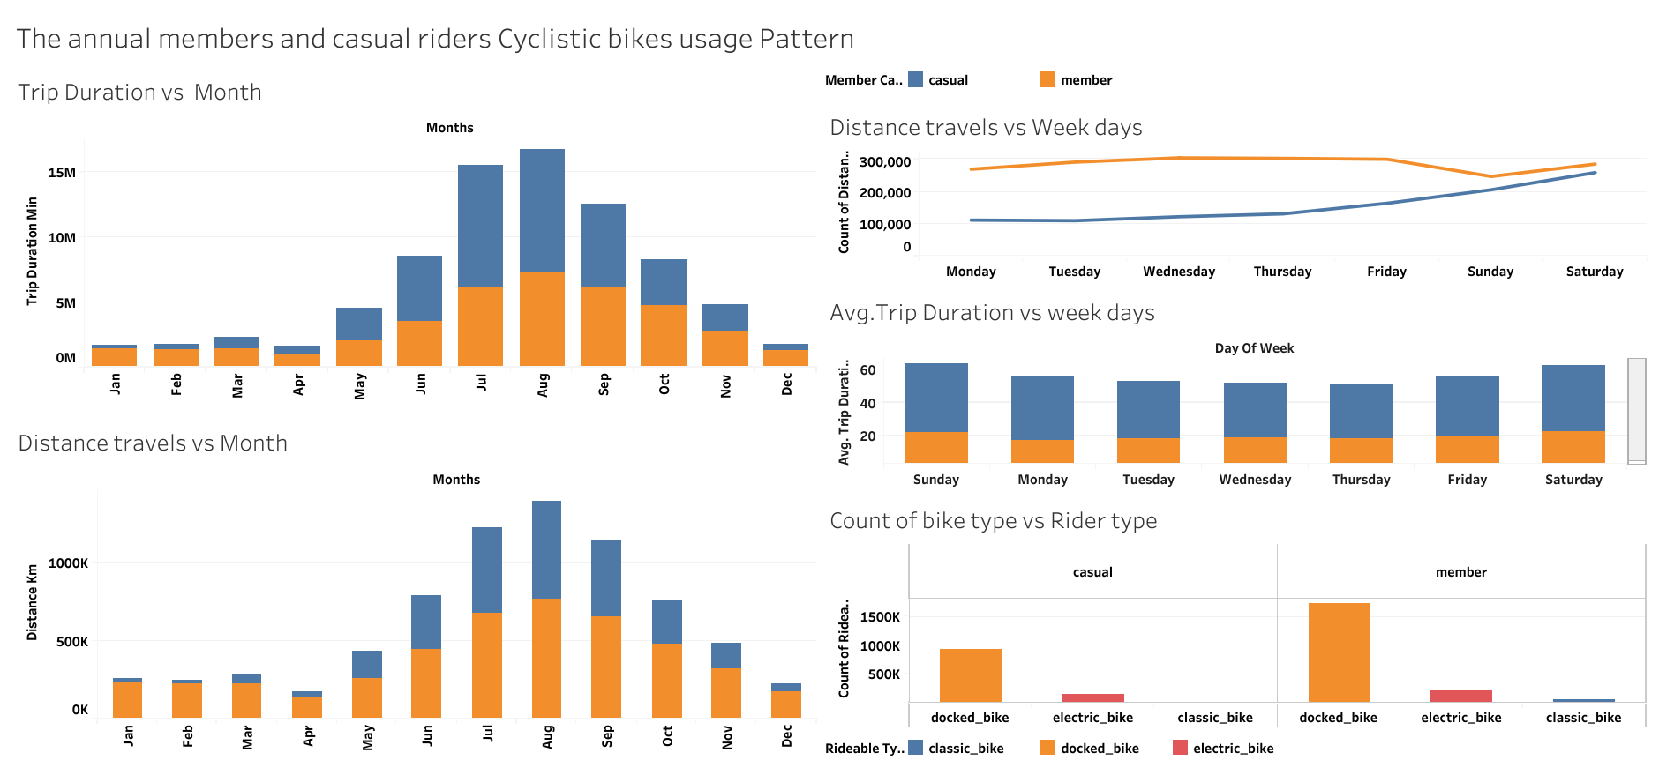

Slide 2
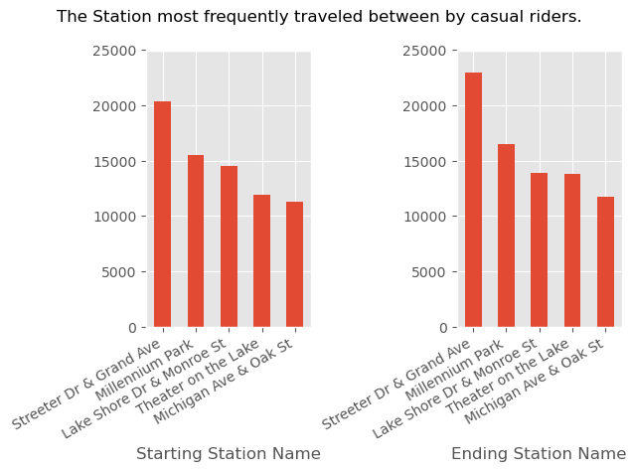
Observations and Recommendations
Our Mane area of interest is how do annual members and casual riders use Cyclistic bikes differently and how can we morph our marketing strategy in order to convert casual riders into annual members?
Targeted Marketing and Membership Incentives
Observation: Casual riders predominantly use bikes, with Streeter Dr & Grand Ave station being both the top starting and ending point, boasting nearly double the numbers of the next most popular station.
Strategy: Implement a membership discount specifically at this high-traffic station. Coupled with an extensive marketing campaign, this initiative aims to attract more customers, whether they are beginning or concluding their rides here.

Slide 3
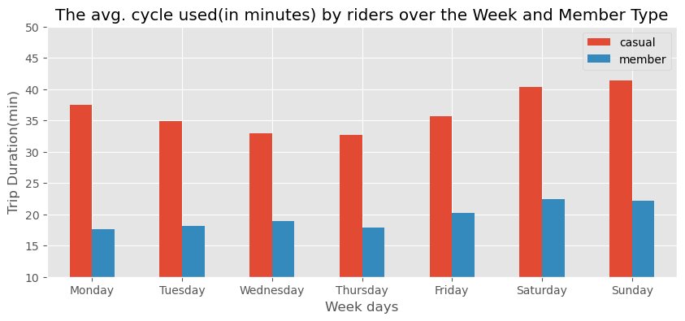
Observations and Recommendations
Our Mane area of interest is how do annual members and casual riders use Cyclistic bikes differently and how can we morph our marketing strategy in order to convert casual riders into annual members?
2.Enhancing Membership Appeal:
Current Insight: Our product enjoys strong user satisfaction; however, our attraction rates remain suboptimal. The challenge lies in understanding why customers hesitate to commit to membership.
Solution: The primary concern is the perceived lack of substantial benefits upon enrolling as a member. To address this, we need to.
Reevaluate membership pricing to ensure it offers clear value.
Introduce exclusive benefits that make membership feel rewarding.
Create a sense of exclusivity and "special" status for members.
* Casuals surpass members everyday. So it is clear that casuals do enjoy the product.

Slide 4
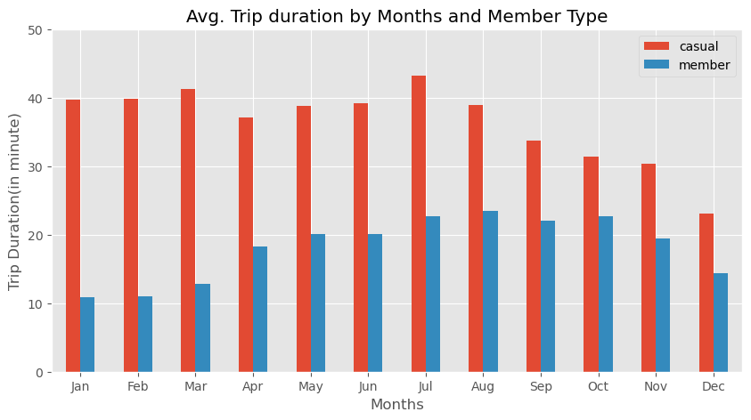
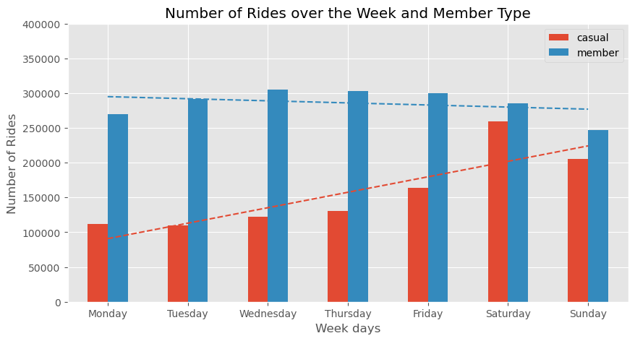
Observations and Recommendations
Our Mane area of interest is how do annual members and casual riders use Cyclistic bikes differently and how can we morph our marketing strategy in order to convert casual riders into annual members?
3. Seasonal and Temporal Engagement Strategies:
Usage Patterns: Analysis shows a peak in bike usage during the spring season. Casual users tend to ride on weekends, whereas members predominantly use bikes on weekdays.
Recommendations:
Offer weekday discounts and subscription incentives to convert casual users into members.
Introduce special rates and promotions for warmer months and weekends to appeal to both casual users and members.
Consider implementing lucky draws and other engaging activities to enhance the appeal of membership.

